Slide 1
DSA Assignment Group 15
Anannya Trivedi 2021A7PS2008P
Phani Sai Sree Ganesh Vemuri​ 2021A7PS1631P
Revant Sai Tanneeru 2021A7PS2536P
Saavi Deshpande 2021A7PS2436P
Shardul Wadajkar 2021A7PS2419P

Slide 2
contents
Introduction to Mounds​
Structure Definition and Global variables
Brief explanation of the algorithm
main Function
val Function
randLeaf Function
findInsertPoint Function
insert Function
​ancestor Function
binarySearch Function
ExtractMin Function
moundify Function
​RemoveMin Function
readValues Function
extractAllValues Function

Slide 3
Introduction to Mounds
Mounds are trees of sorted lists where the time complexity of insert() function which inserts a new value in the mound is O(log(log n)) and the time complexity of extractMin() function which extracts the least value present in the mound is O(log n). ‘n’ being the number of nodes in the tree.
The list present at each node of the tree is sorted, the first value being the least, and so are the nodes. The children of each node are greater in value than the parent. This is the mound property.

Slide 4
A brief Explanation of the algorithm

Slide 5
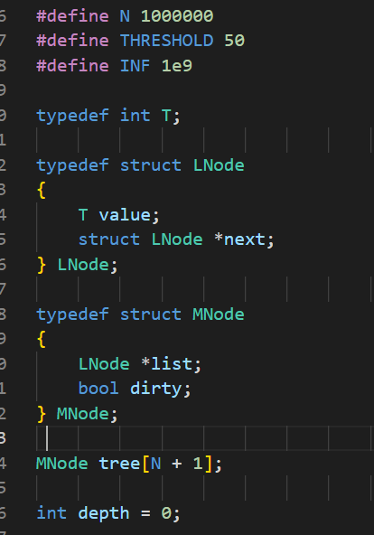
Structure definitions and global variables
In the code snippet attached, N has been defined with a constant value of 100000 which represents the maximum number of nodes our mound can accommodate.
THRESHOLD defined as 50 is the maximum number of attempts to find a suitable insertion point when inserting a new node.
INF is a very high valued integer that is to be returned as the value of an empty mound node.
LNode is the structure for the nodes of the linked list pointed to, by each node of the binary tree, which consists of a value of type ‘T’ which in this case is int, and a pointer next of type Lnode which points to the next node in the list.
MNode is the structure for the nodes of the binary tree of the mound, which consists of a pointer list of type Lnode which will point to the list associated with each node of the binary tree, and a Boolean variable dirty, which will be set to true when the node values don’t obey the mound property.
An array named tree of n+1 MNodes is declared, and an integer that represents the depth of the tree is initialized to 0 considering the tree is empty initially.

Slide 6
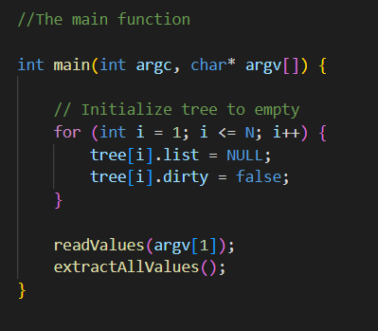
main Function
In the main() function, the tree is being initialized with default values, NULL being the default value for list, and the dirty field for each node is being set to false, since there are no values that could disobey the mound property.
The readValues() function has been used to read data as input from the given text file, the absolute path of which would be entered by the user while running the program in the terminal and the extractAllValues() function has been used to extract values from the mound and print them into another text file.
These functions are explained in greater depth a few slides ahead.

Slide 7
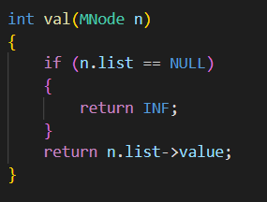
val Function
The val() function returns the value stored at the given Mnode of the binary tree. In case the Mnode is empty i.e. it has a list that points to NULL, INF that is 1e9 is returned.

Slide 8
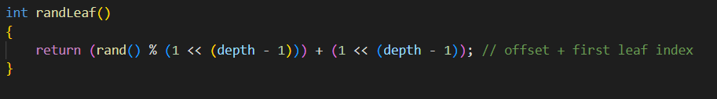
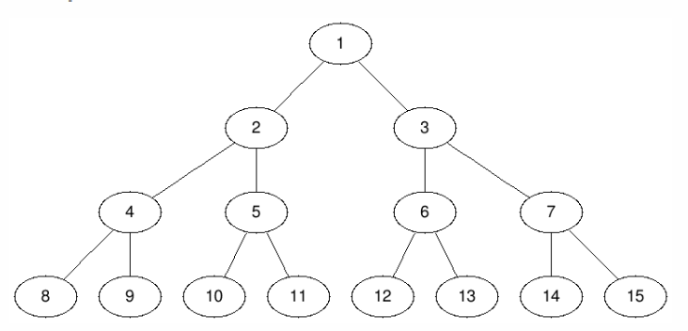
randLeaf Function
randLeaf() function returns the index of a random leaf of the binary tree.
Returns values
1 + rand()%1
2 + rand()%2
4 + rand()%4
8 + rand()%8

Slide 9
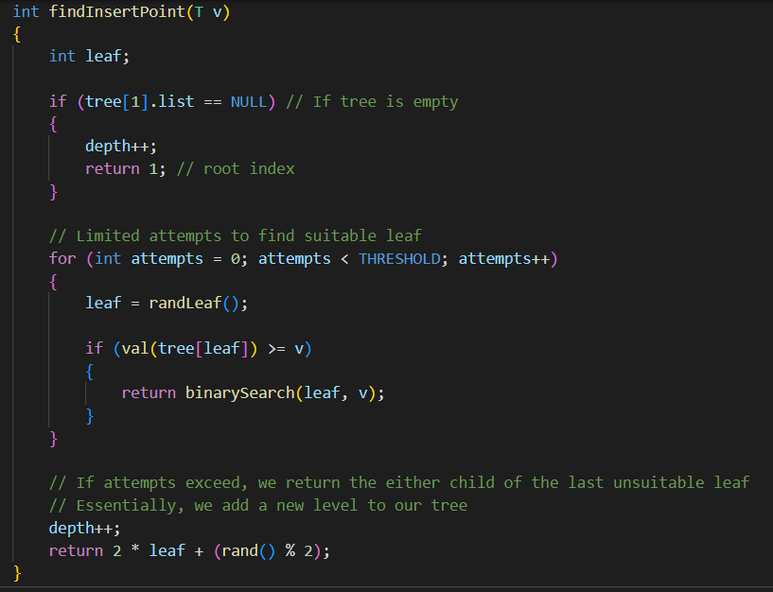
findInsertPoint Function
findInsertPoint() function returns the index of the node on which the insertion is to be performed.
In the first if condition, the case of the tree being an empty one is being probed. If the tree is empty, the depth is increased by 1, and 1 is returned as the new value v will be inserted at the first index(our array being 1-based and not 0).
If the tree is not empty, we run a loop THRESHOLD times, and we generate random leaf indices using the randLeaf() function.
If v is less than or equal to the value at the randomly generated leaf index, a binary search is run on its ancestors using the binarySearch() function because considering the mound property, the correct position of v then lies somewhere above the leaf.
If we do not find a suitable leaf in a fixed number of attempts(THRESHOLD), we insert v as the value of a new leaf, at a new level to optimize aur insertion. Therefore, the depth is incremented, and the index of a randomly generated new leaf is returned.

Slide 10
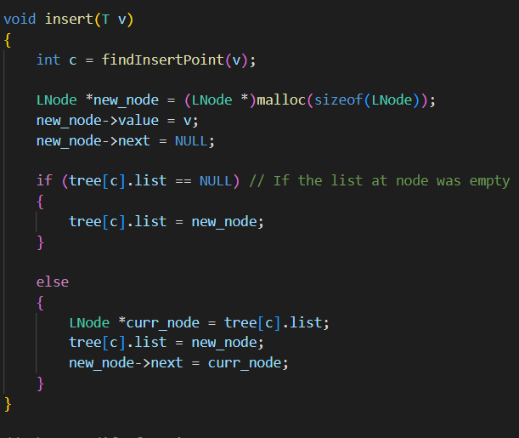
insert Function
The insert() function is used to insert a new value in the mound.
The findInsertPoint() function returns the index at which the value can be inserted.
A new LNode is created using dynamic memory allocation. Its value is set to the value that has to be inserted and its next pointer points to NULL.
If the list at the index returned by the findInsertPoint() function is empty then the list is simply initialized with the node created.
Else, the newly created node is inserted as the first node of the list.

Slide 11
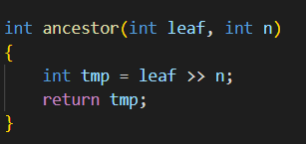
ancestor Function
The ancestor() function returns the ancestor of the given leaf at the nth level. The index of the nth-level ancestor of a given leaf would be (leaf_index) / 2^{n} implemented using the right shift operator.
For example, for leaf_index = 13;
n=0 returns the index 13,
n=1 returns the index 6,
n=2 returns the index 3 and
n=3 returns the index 1,

Slide 12
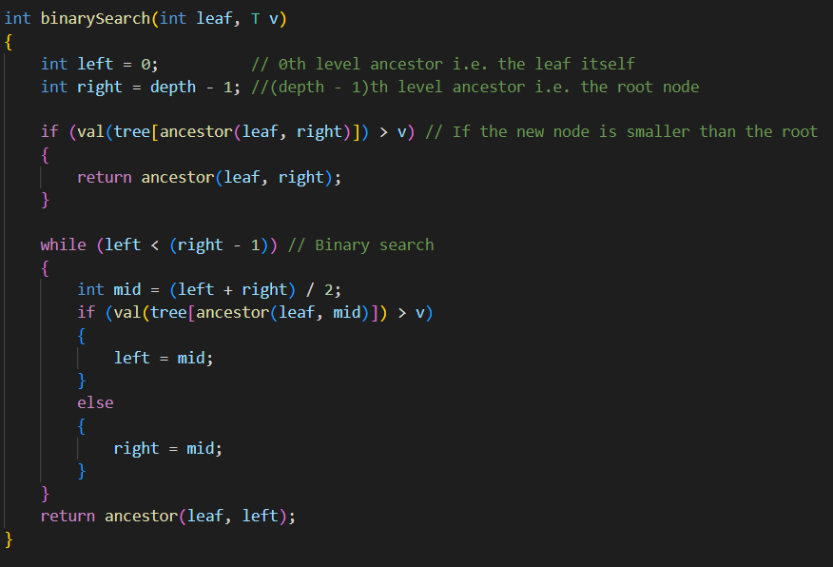
binarySearch Function
The integer variable left is set as 0 and right as depth-1. These represent the different levels on which the binary search would be executed.
If the value v is less than the root node value, then the root node has to be replaced. Therefore, the ancestor at
(depth-1)th level is calculated.
Else binary search is executed on the different levels, and finally, the ancestor() function returns the index of the ancestor at the suitable level.

Slide 13
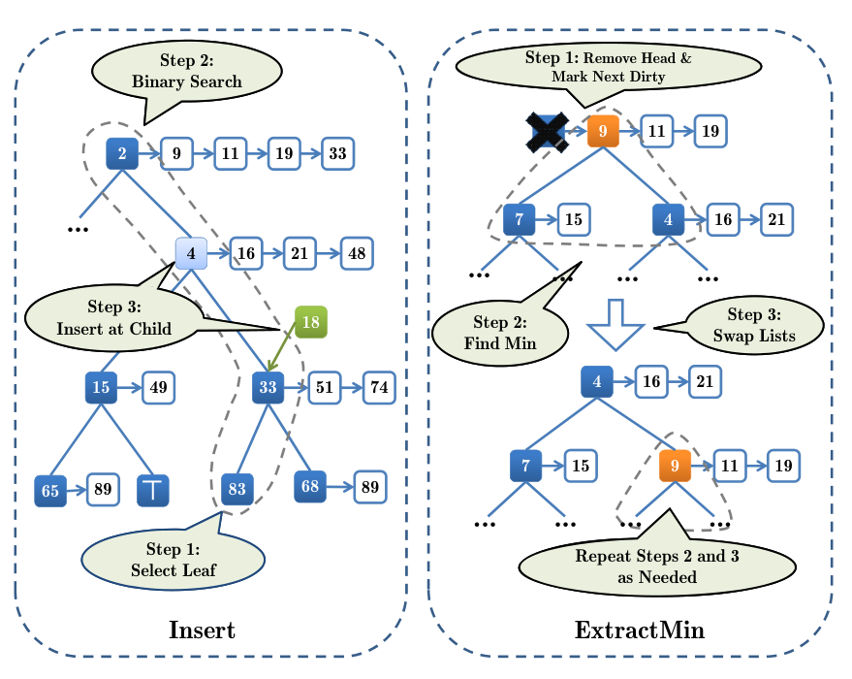

Slide 14
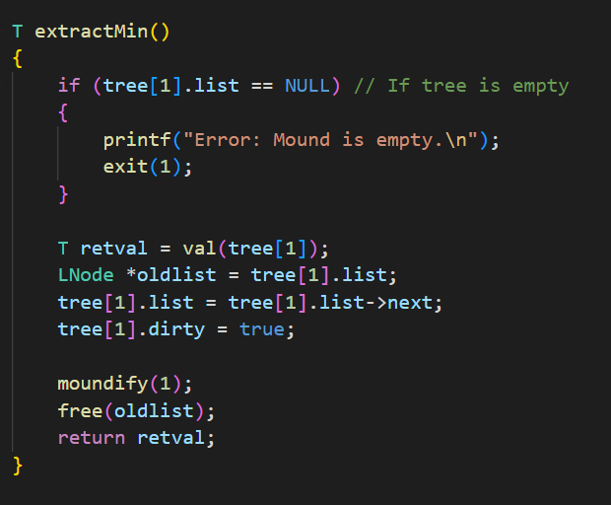
extractMin Function
The extractMin() function returns and removes the minimum value of the mound.
The first if condition prints an error message if the tree is empty since there is nothing to remove.
If the tree is not empty, retval variable stores the minimum element of the mound which is going to be the value of the root node of a mound, always.
The retval valued node is then removed from the list at the first MNode. The list is made to point to the next element and the oldlist is then freed.
The dirty field for the first MNode is set to true since we need to check if the new element that has acquired the position of the previously removed one, follows the mound property or not.
Thus, moundify() is run on the first MNode, and retval is returned. The function moundify is explained in detail in the next slide.

Slide 15
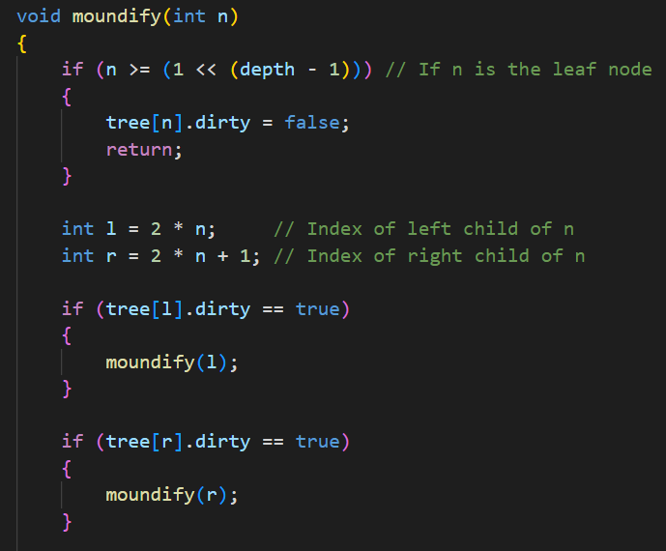
moundify Function
The moundify() function makes sure that the mound property is being followed and makes appropriate changes if it isn’t.
According to the mound property, all Mnodes’ values should be less than their child Mnodes’ value as well as all Lnodes’ values of their respective lists.
If the node at which moundify is applied, is the leaf node, that is its index is greater than or equal to 2^{(depth – 1)}, then the dirty field is set to false. Since it has no children, there’s no way it can disobey the mound property.
If the given node is not the leaf, the variable l stores its left child’s index, and r stores the right child’s index. According to the algorithm, moundify is applied recursively on the left and the right child first.

Slide 16
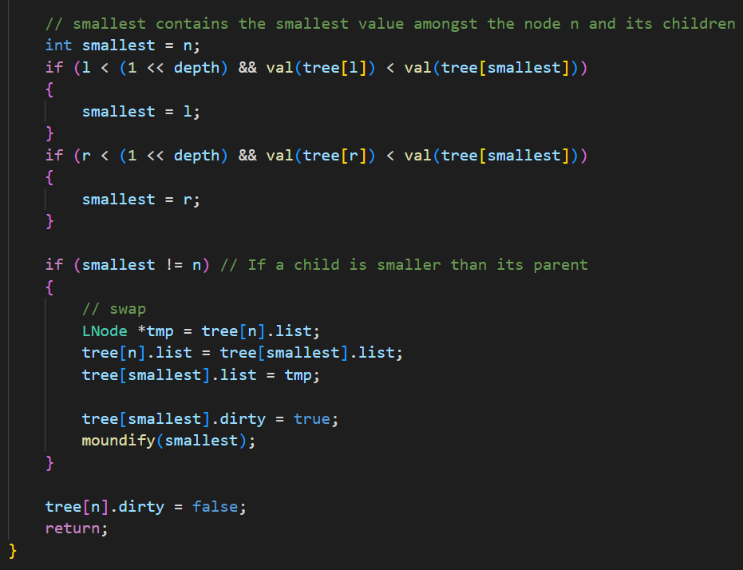
moundify function
Now, whether the left child’s index is within the tree is checked by the expression (l < (1<<depth)) which evaluates to l < 2^{depth} and if its value is less than its parent, then the variable smallest is assigned its index.
A similar condition is checked for the right child. Finally, if smallest has any value other than n, it means the mound is violating the mound property.
In this case, the MNodes along with their list are swapped and moundify is recursively called on the swapped node now.
If the above-mentioned if condition doesn’t evaluate to true, it means that the mound is following the mound property, and the dirty field is hence set to false.

Slide 17
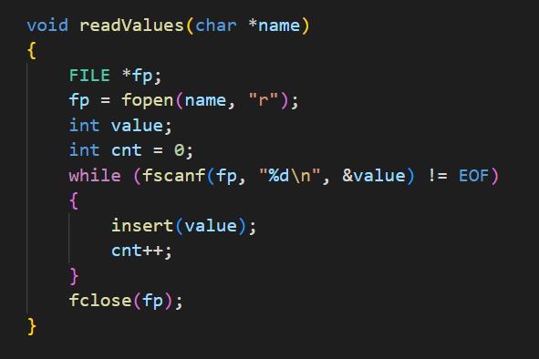
readValues Function
The readValues() function takes the absolute path of the data text file provided as input. It then reads all the integer values from the file and inserts them in the mound. Once it reaches the end of the file, it closes it.

Slide 18
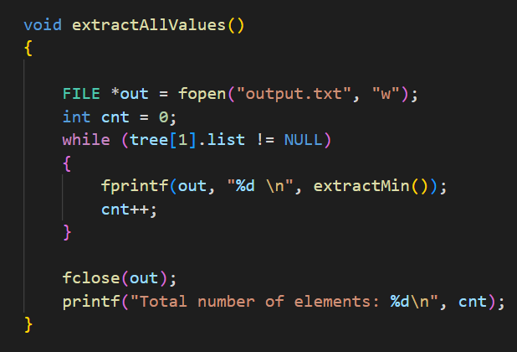
extractAllValues Function
The extractAllValues() function uses the extractMin() function to remove the minimum value from the mound and output it in the file “output.txt”. This continues till the mound becomes empty.
The count of the total number of elements has also been printed using a counter variable “cnt”.

Slide 19
THANK YOU

